Slide 1

Technical Presentation
Presented by: Jenny burgos

Slide 2
Context
Since 2008, AirBnb has emerged as the great contender of hotel businesses offering hosts and guests a unique and more personalized way of traveling at a cheaper cost.
The dataset describes the listing activity and metrics of AirBnB rentals in several cities in the US as of 2020
By conducting data analysis, business implications and strategies can be drawn in the next calendar year. This study used both descriptive and inferential statistics to predict the rental prices in cities in the US

Slide 3
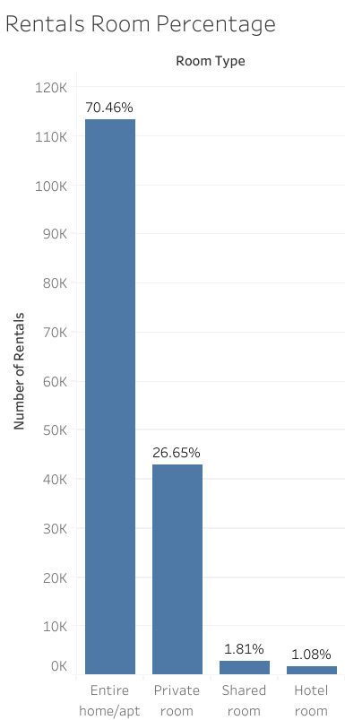
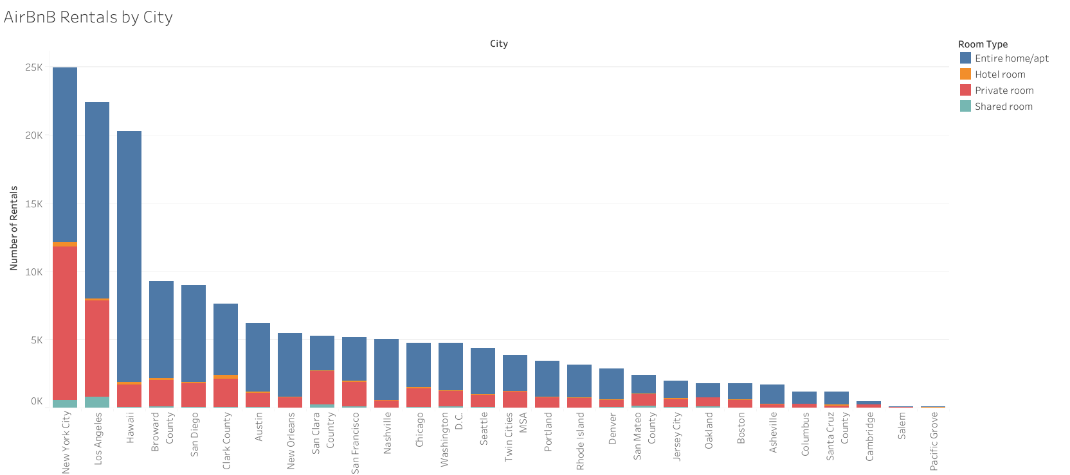
Majority of the rental listings are entire home/apt type across US cities
Note:
* The graph excludes rentals that have $0 or $1 price per night.

Slide 4
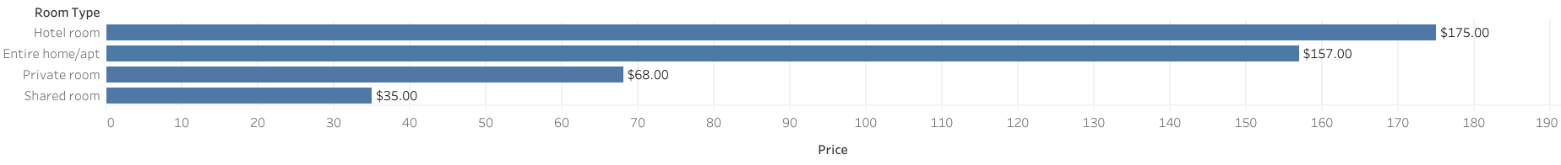
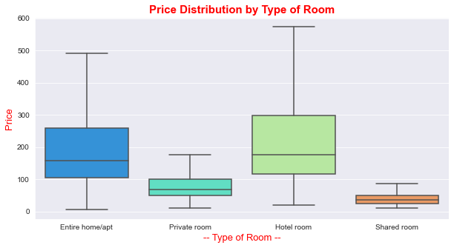
The average price distribution of hotel room has the widest range after excluding outliers
Key Insights:
Median was used to represent the average price due to skewed distributions.
Extreme values(outliers) and rows with $0 and $1 were removed.

Slide 5
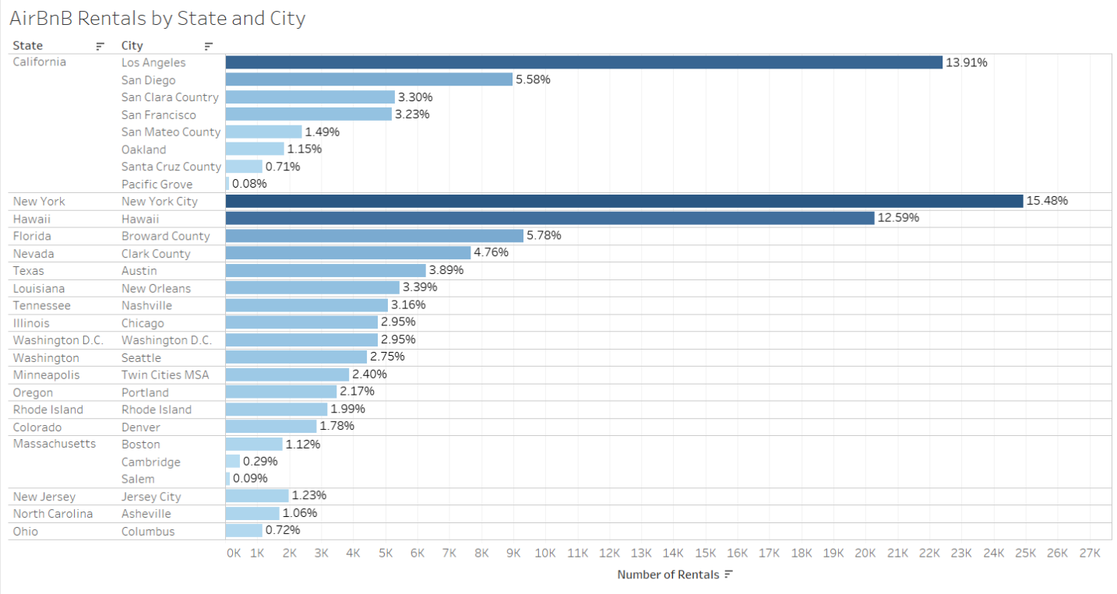
New York City (15.48%), Los Angeles (13.91%) and Hawaii (12.59%), top 3 cities with the highest number of rentals
Key Insights:
The bulk of the rentals are from the state of California (29.45 %) with LA as one of the key cities.
New York and Los Angeles are tourist attraction cities with highly dense population.

Slide 6
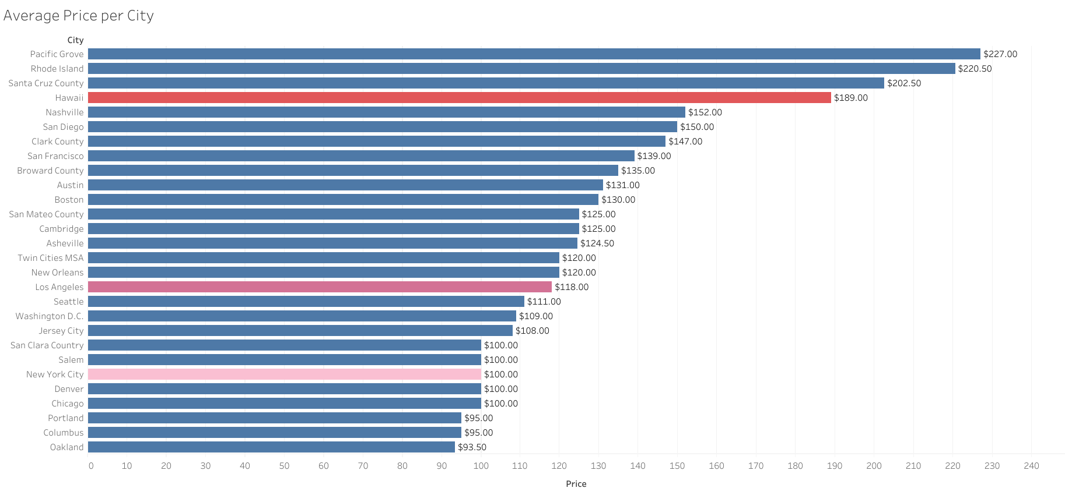
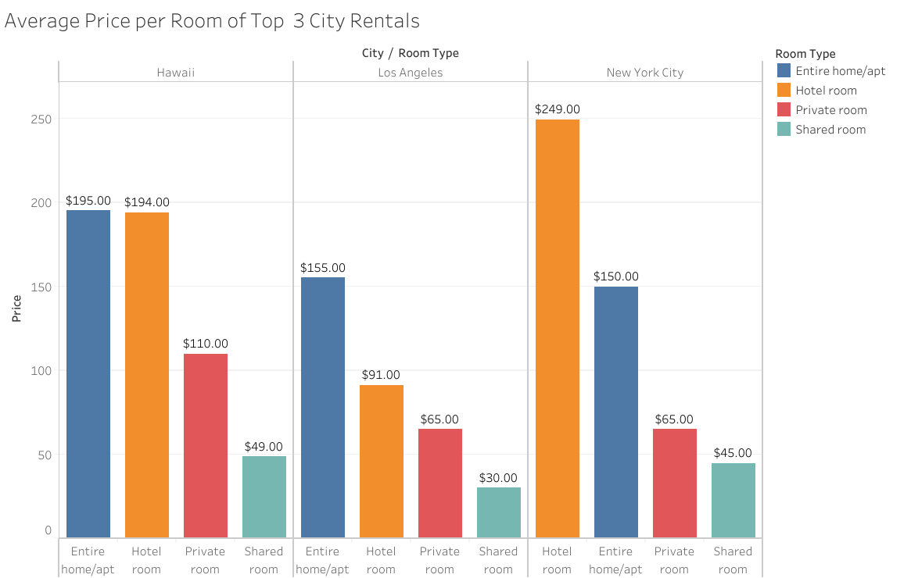
By dissecting the rental prices in 3 top cities, New York City’s price range varies widely the most
Key Insights:
It can be interpreted that the price range in New York City speaks about the variety of tourists coming in and out, from a backpacker to a wealthy businessman. It’s not only a tourist attraction but the business capital of the country.

Slide 7
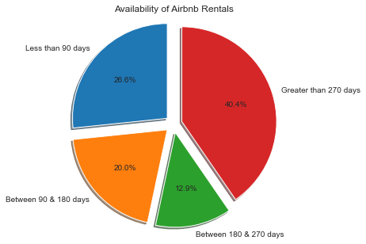
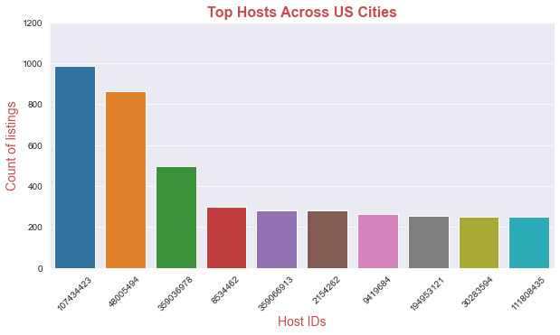
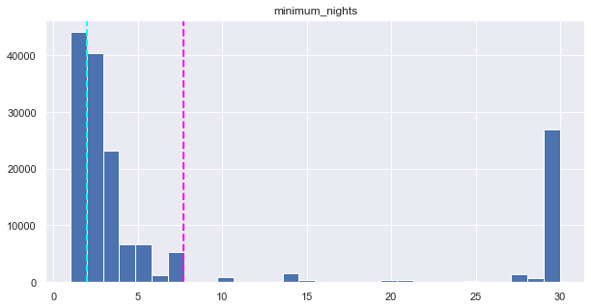
Some descriptive statistics of rental listings across US cities
Note:
Rentals that have 0 availability and with minimum nights more than 30 were excluded.
Top 10 hosts were only selected among hundreds of host.
Key Insights:
The distribution of both the minimum is skewed. The pink broken line represents the median. This can be interpreted that majority of the rentals have minimum nights of 8 days and below.

Slide 8
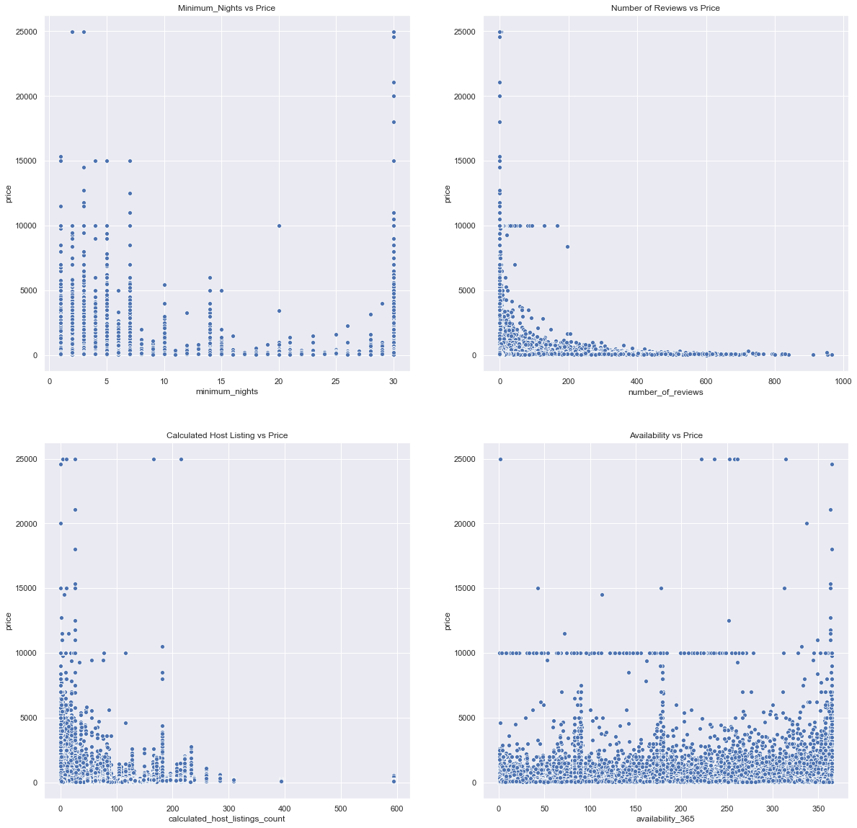
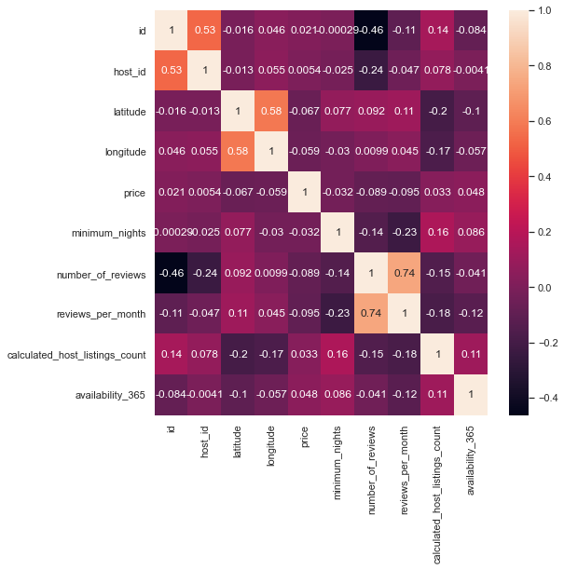
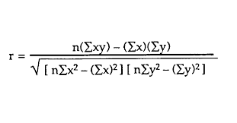
By conducting inferential statistics, none of the variables is strongly correlated to the price, indicative to be non predictors
Key Insights:
Pearson’s Correlation was calculated for each variable using the following formula:
After conducting linear regression, r squared = 0.015. There’s no enough evidence that the variables can be used to predict the price.

Slide 9
Recommendation
Home/apartment type room has the highest number of rentals and it can be interpreted that its’s cheaper than the cost of hotel while accommodating more guests. Therefore, more rental listings of this type should be available.
Rental listings in tourist attraction cities are in demand and are available for more than 270 days are sellable. Prices should be adjusted with regards to location, seasonality and less expensive than nearby hotels to attract more guests.
The result of conducting inferential statistics indicated that none of the variables (e.g. availability, minimum nights, number of reviews) are correlated to the price and obtained a very low r squared value. There fore they are not good predictors of prices. It is suggested that sufficient data needs to be gathered more in the future to create a better business plan.

